Slide 1

Session 1.4
Revizto - Game Engine Technology Brings
Next Generation Design and Construction Coordination
Luke Johnson
Virtual Built

Slide 2
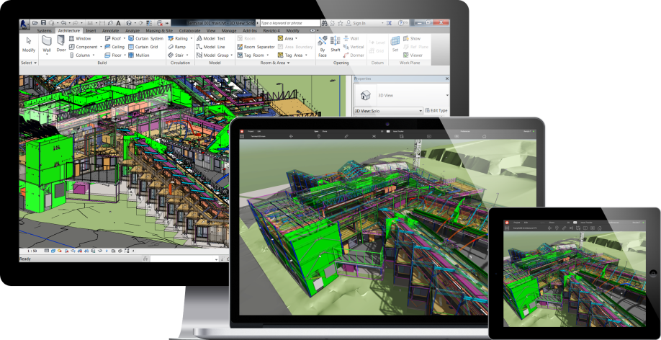
What is Revizto
Revizto is a real-time, 3D model based issue tracking software for AEC teams with a focus on collaboration and BIM project coordination.
Using gaming technology and cloud solutions, Revizto brings together various BIM and CAD data to track all project issues in one centralized 3D environment. The Revizto platform is intuitive, easy-to-learn and adaptable to BIM workflows. With Revizto, BIM implementation is streamlined, allowing teams to speak a common language and share a single window into all project information.
Share | Present | Collaborate
Instantly share your BIM data with project stakeholders. | Accurately convey your design as if it was already built. | Identify, track, and solve problems throughout all phases of the project life cycle.

Slide 3




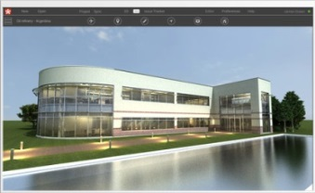









General Revizto workflow
Clashes as issues
Navisworks
Collaborate
Cloud
Issues and
markups
Share
AutoCAD
Convert
Present
Revit
Also works with
Supported file formats
Civil 3D
SketchUp
ArchiCAD
BCF
DWF
FBX
IFC
PDF

Slide 4
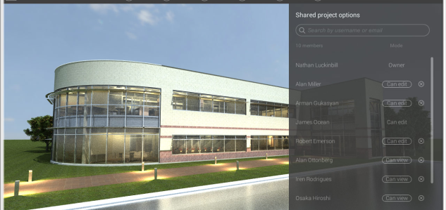
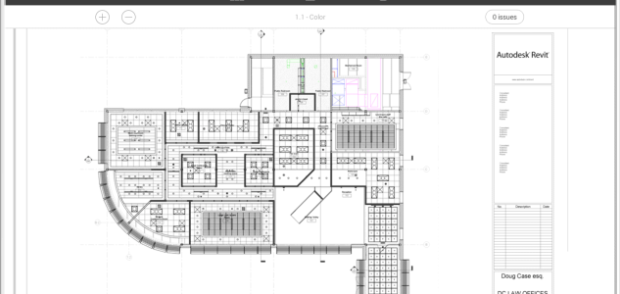
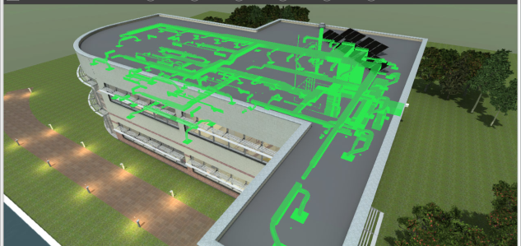
Export and share your model
Cloud Sync and Share
Share Revizto projects with your team through the cloud. Sync the model to push large attachments placed in the Issue Tracker or updated model.
Export 2D Sheets
Export 2D Sheets from Revit, Navisworks, AutoCAD and ArchiCAD to further mark up and collaborate in Revizto. You can also import PDF or DWFx files.
Merge
Combine several models from different authoring BIM/CAD software to create a federated model within Revizto. Supports import IFC and FBX.

Slide 5
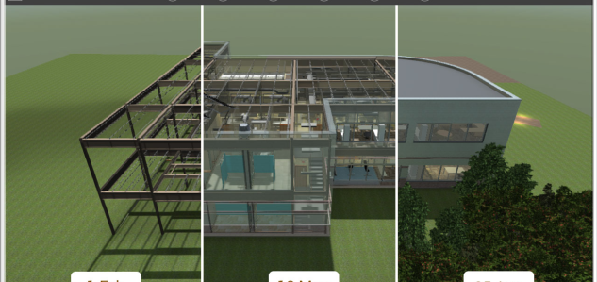
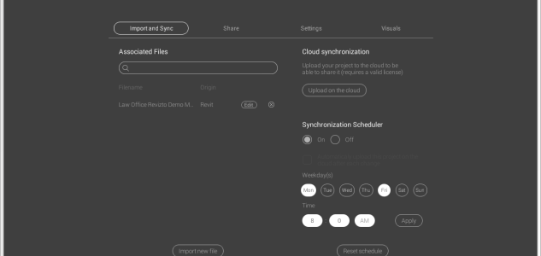
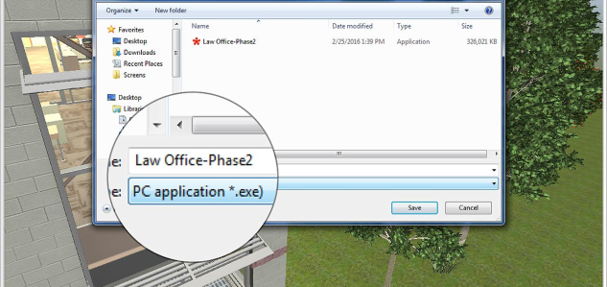
Export and share your model
Revision control
View all revisions of your project which have been synced to the Cloud. You can open any revision and revert to it at any time.
Export scheduler
Schedule recurring exports per desired day and time. Revizto will launch your authoring program and export the latest model to your project team.
Export to .exe or for MAC
Share your project as a self-executable file. Any user can open this file on 64-bit Windows PC or MAC without Revizto installation.

Slide 6
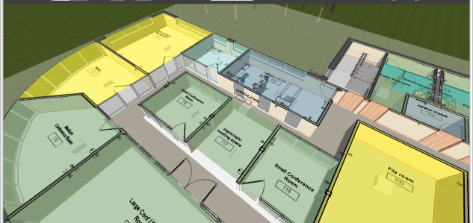
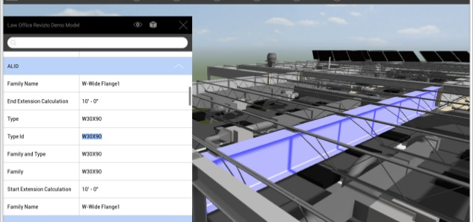
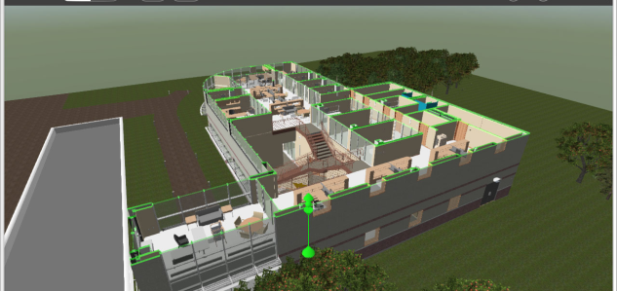
Explore and present on any device
2D Sheets
The home of all 2D documents in Revizto. Use sheet overlay to combine your 2D plan with the 3D model instantly to provide a better understanding of your project.
Objects
Discover detailed information about any object in one double click. Any object or object’s category can be made transparent or semi-transparent.
Viewpoints / Section cuts
Save any spot in the scene for navigation and presentation purposes. Each viewpoint can contain a section cut and category visibility/transparency settings.

Slide 7
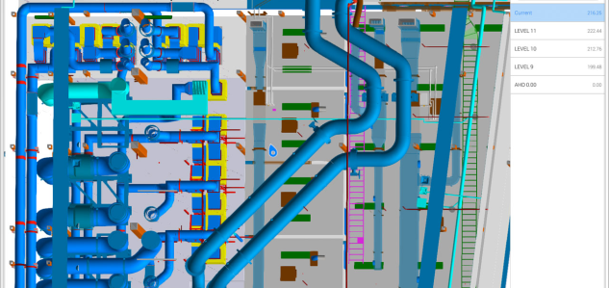
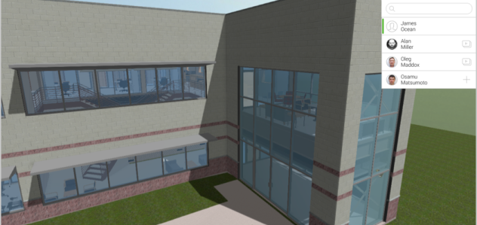
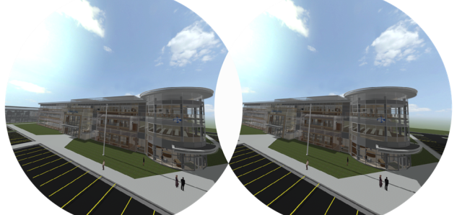
Explore and present on any device
2D map
An intelligent map that shows your exact location, elevation, grid intersect and the Revit room names on surrounding you. Within 2D map you can instantly teleport to any level or area of your project in one double click.
Camera Sharing
Providing the WOW factor. Do remote presentations or discuss potential problem areas with "camera share" functionality. It transmits your movements on other remote devices without virtually zero delay at breathtaking speeds.
VR Support
Explore your project in VR. Revizto works natively with Oculus and HTC Vive and instantly creates an immersive, true-to-scale VR experience in seconds allowing users to explore real model data and coordination issues in VR.

Slide 8
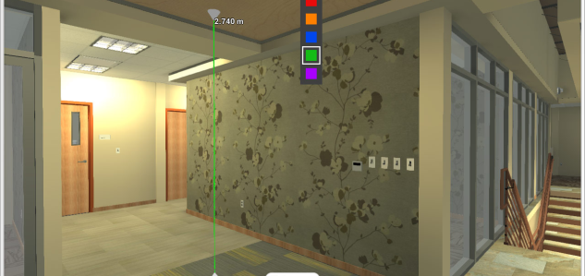
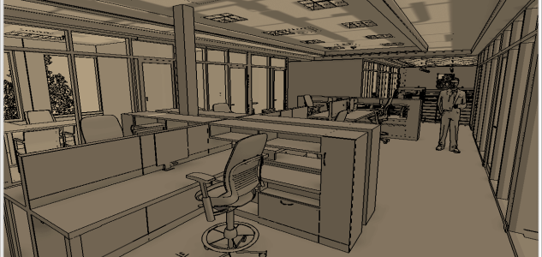
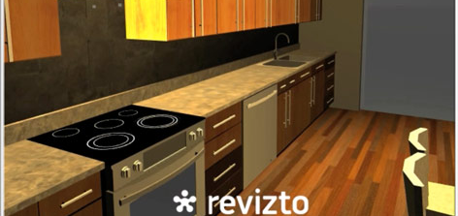
Explore and present on any device
Ruler
Snaps to measure the closest surface, minimum distance between two objects or any other points all based on the geometry of your authoring software.
Sketch Mode
Avoid distracting details and questions around materials while working in the preliminary stages of the project. Introduce your first ideas clearly.
Watermark
Protect your project with a watermark before you share it to public. In Revizto, watermarks can be added from an image such as a company logo.

Slide 9
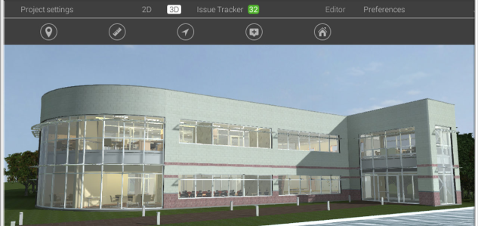
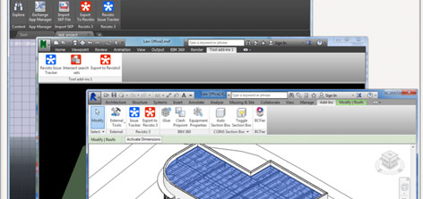
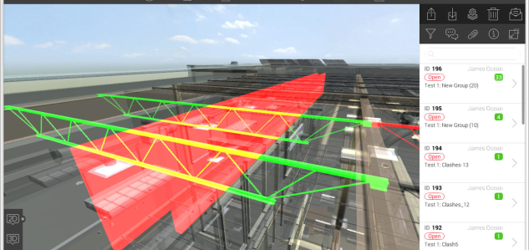
Collaborate with your team in real time
Instant notifications
Assignees and watchers of issues get instant notifications about new comments and updates – in-program and via e-mail. Customize the e-mail notifications settings to see only what you need and to avoid having them all routed to your trash.
Plugins
Create new issues and markups directly from BIM/CAD program or view existing issues by launching the Issue Tracker. By double-clicking on the issue a new view will be created in your authoring software to show the problem.
Clashes from Navisworks
Import all clashes from Navisworks into Revizto Issue Tracker. Next, assign accountability, deadline and specifics notes to ensure they get resolved in a timely matter. This will also allow users to view in their native modeling software.

Slide 10
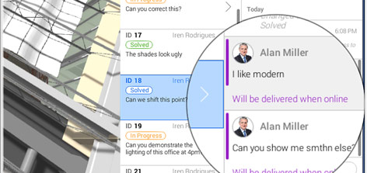
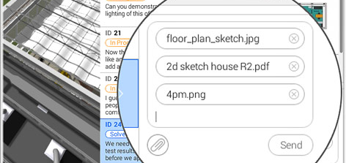
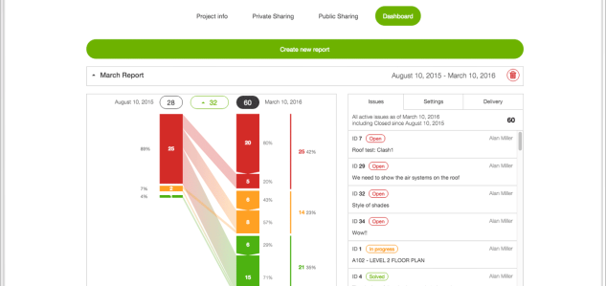
Collaborate with your team in real time
Offline usage
The Issue Tracker works perfectly offline. This allows users to bring their live model in the field. The issues created while offline will be synced when you regain your connection to the Internet. Therefore, you can use Revizto mobile version on iPad or Android on building site for issue tracking.
Attachments
Attach images and documents in the issue timeline/ chat window. Users can take photos in the field and mark up the photos before attaching to the issue. Likewise, office counter parts can make screenshots of what's actually going on in their model and paste those into the log.
Issue Reports
On the Revizto Workspace, view an interactive graph showing the issue status and dynamics. Set up an automatic issue report to be sent to you in PDF or Excel format or pull a report instantly from your defined parameters within the Issue Tracker.

Slide 11
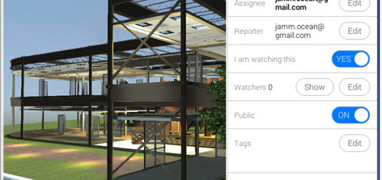
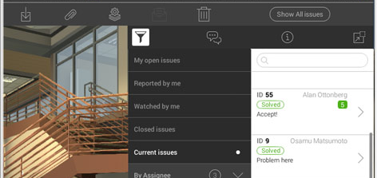
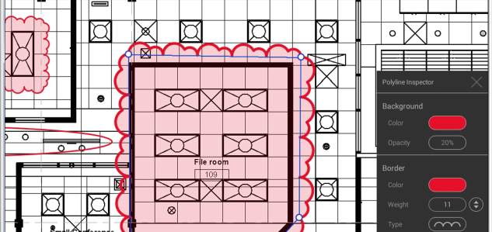
Collaborate with your team in real time
Public and private issue
Make the issue private if you don’t want it to be seen by everyone. This gives you an ability to manage the issues with different teams within one project.
Advanced filtering
With the filtering system it is easy to find any issue or to view a specific group of issues. This is where users take full advantage of tagging issues.
Markup tool
Explain the problem with a simple visual language using the markup tool. Easily create a new screenshot for the current issue and markup it.

Slide 12








Typical workflow for Architectural firms
Local files
RVT
Fix issue
Link
Info Exchange
Master
RVT
Export
Scheduler
NWF
Master
Export
Local Revizto
2D+3D
View issue in Revit
and Navisworks
Append
other
files
Clashes
Sync to Cloud
Federated Revizto project in Cloud
+
Append
Export
Collaborate
Issue Tracker
on Cloud
Open issue

Slide 13





Workflow example for General Contractor
Detailers/MEP subs
Arch firm
Issue status: In progress
Assignee: Detailer
Goal: Task set up
Local files
RVT
Project manager (PM)
Arch firm
Issue status: Solved
Goal: For check
Issue status: Open
Assignee: PM at Arch firm
Goal: Choose a performer
Issue reporter
Audit companies
*all company’s team as watchers
Master
RVT
+
Project manager (PM)
Contractor
Issue status: Open
Assignee: Project Manager
Goal: Approve and forward to Arch firm
Upload on Cloud
Revizto file and
update it every Friday
+
Issue reporter
Project’s Owner
*all owner’s team as watchers
Issue status: Open
Assignee: Project Manager
Goal: Forward to Arch firm
Issue reporter
Contractor
+
Issue status: Open
Assignee: Manager
Goal: For approval
Assignee: Manager
Goal: To close a solved issue
Manager
Contractor
Closed

Slide 14
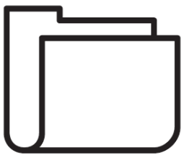




Example of traditional coordination cycle
RVT
DWG
IFC
NWC
NWC
Arch | MEP | Structural
Teams
FTP
General
Contractor
NWF
NWD
NWD
Clashes
Viewpoints
E-mails with screenshots
Reports

Slide 15



Revizto-infused coordination cycle
RVT
DWG
IFC
NWC
NWC
Arch | MEP | Structural
Teams
FTP
General
Contractor
NWF
NWD
NWD
+
Clashes
Revizto
project
New Issues
Work with issues in
Revizto | Revit | Navisworks
Clashes as issues
Revizto on Cloud
Notifications
Reports

Slide 16
What’s new in Revizto 4.4
Ability to color code links, categories and levels. New "Objects" dialog.
Ability to hide linked models and individual objects.
Phases support from Revit.
Tag management system for the Issue Tracker.
Clickable links on sheets.
Interface improvement.

Slide 17
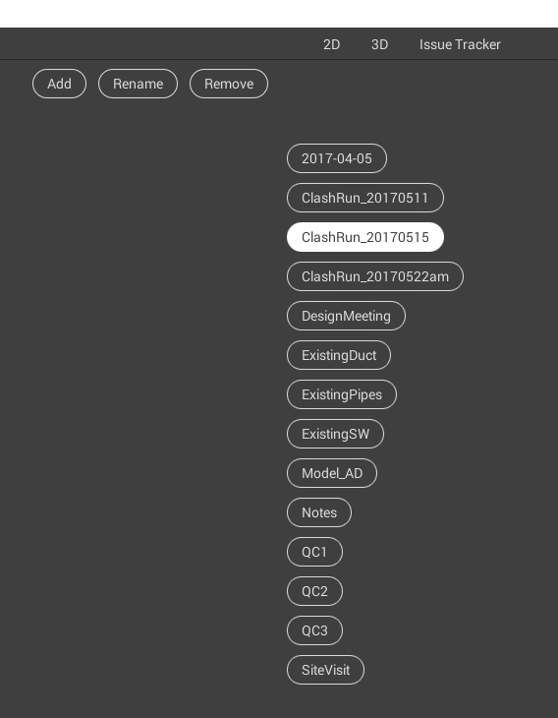
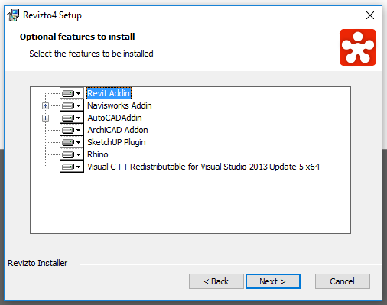
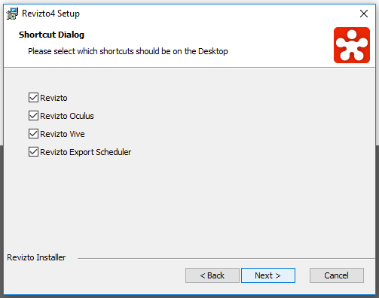

Slide 18
Revizto links
Revizto web site https://revizto.com
User Manual https://help.revizto.com
Revizto video tutorials list https://goo.gl/dMUwPa
Revizto in social media
Twitter @revizto
YouTube www.youtube.com/REVIZTO
LinkedIn Group https://www.linkedin.com/groups?gid=6629194
Facebook www.facebook.com/REVIZTO

Slide 19
Thank you!
Session 1.4: Revizto - Game Engine Technology Brings Next Generation Design and Construction Coordination
Luke Johnson
Virtual Built

